Slide 1
OList Marketing and Retail Analytics
Capstone Project
Presented By : Vijayraj K Poojary | Snehil Tiwari | Vinay Patil Data Analytics | Data Science | DS C47 IIITB | 2023

Slide 2
Agenda
Objectives
Background
Visualizations
Insights
Recommendations
Appendix –
Data Sources
Data Methodology
Data Assumptions

Slide 3
Objective
Our main objectives for this project are as follows:
1. Identify the top products contributing to revenue and the leading product category using Pareto Analysis.
2. Enhance our understanding of customer purchase behavior through market basket analysis.
3. Determine which items are most likely to be purchased individually or in combination with other products.

Slide 4
Background
OList, an e-commerce company, has recently faced financial losses and seeks to optimize its inventory management to reduce unnecessary costs.
To meet customer demands, they must stock a vast array of products in their warehouses, which adds to their operational costs.
Efficient inventory planning is vital for the organization's profitability.

Slide 5
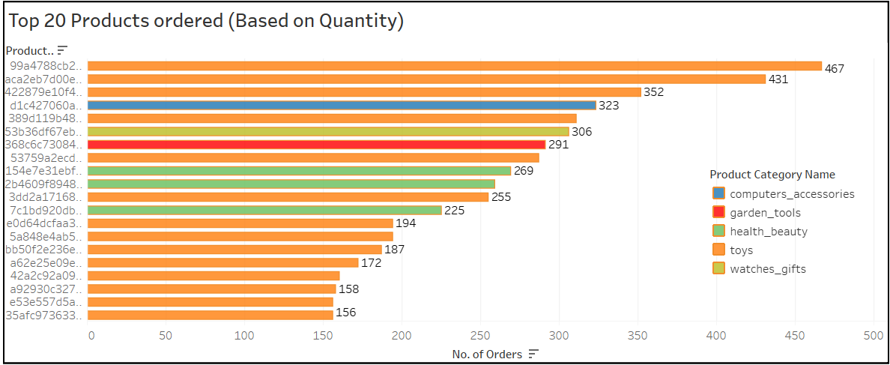
Visualizations
Top 20 Ordered Products by Quantity
The highest ordered product, with 467 orders, belongs to the Toys category.
The majority of frequently ordered products in the top 20 also belong to the Toys category.

Slide 6
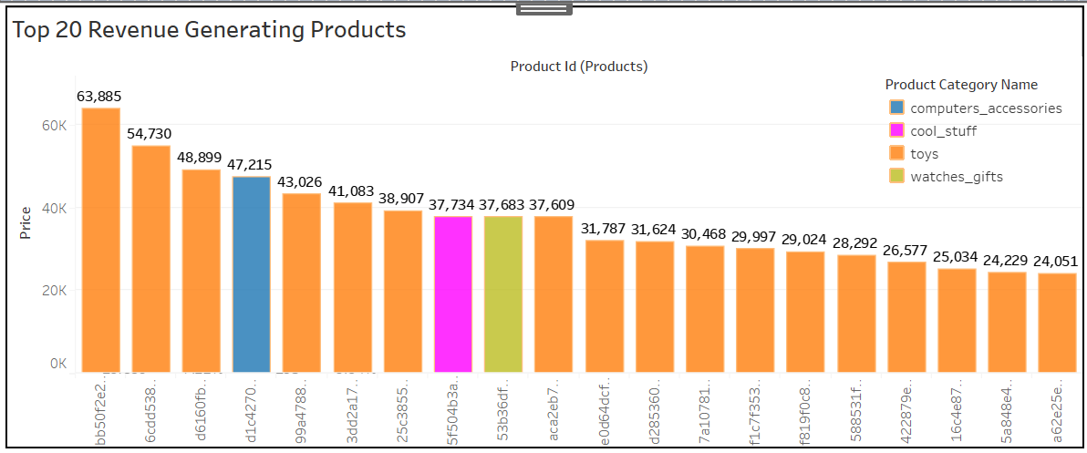
Visualizations
Top 20 Ordered Products by Revenue
The highest revenue, 63,885, is generated by a product in the Toys category.
Most products in the top 20 generating high revenue are also from the Toys category.

Slide 7
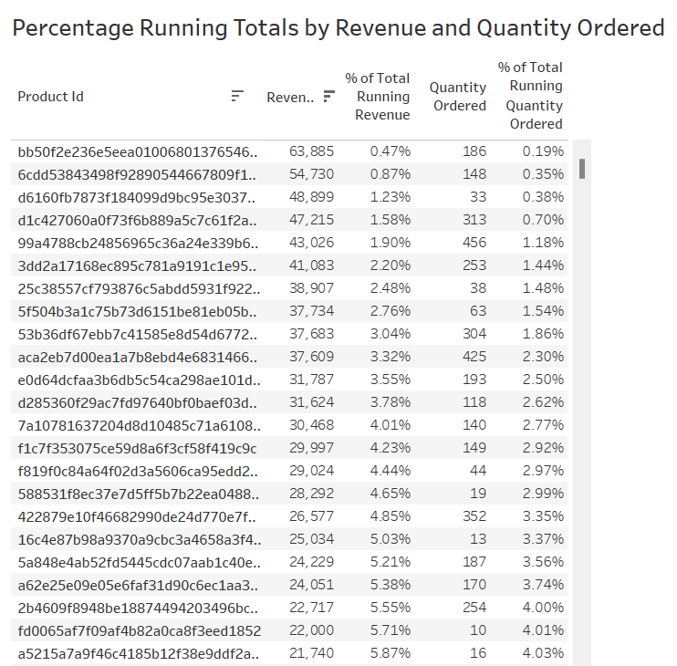
Visualizations
Percent Running Totals
We've broken down the Percentage of Total Running Revenue and Quantity Ordered by Product Id.
This allows us to identify the contribution of each product to the total revenue.

Slide 8
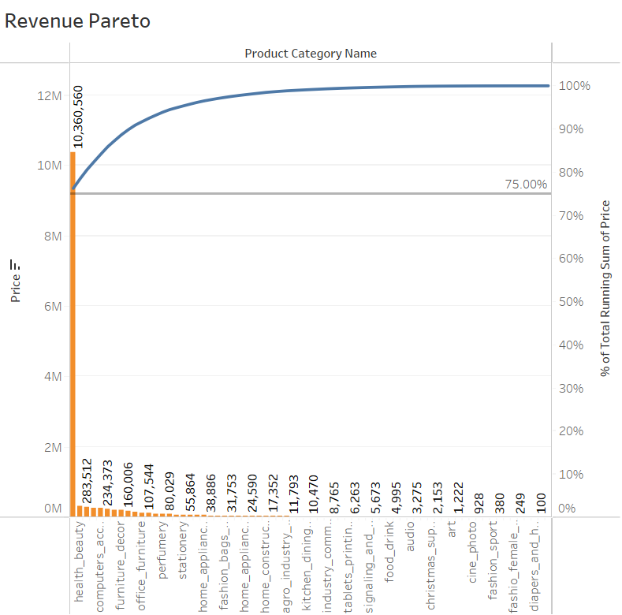
Visualizations
Revenue Pareto
Toys, health_beauty, and watches_gift together generate 80.56% of the revenue.
Toys alone account for 76.23% of the revenue, while the remaining 70+ product categories generate 19.44%.

Slide 9
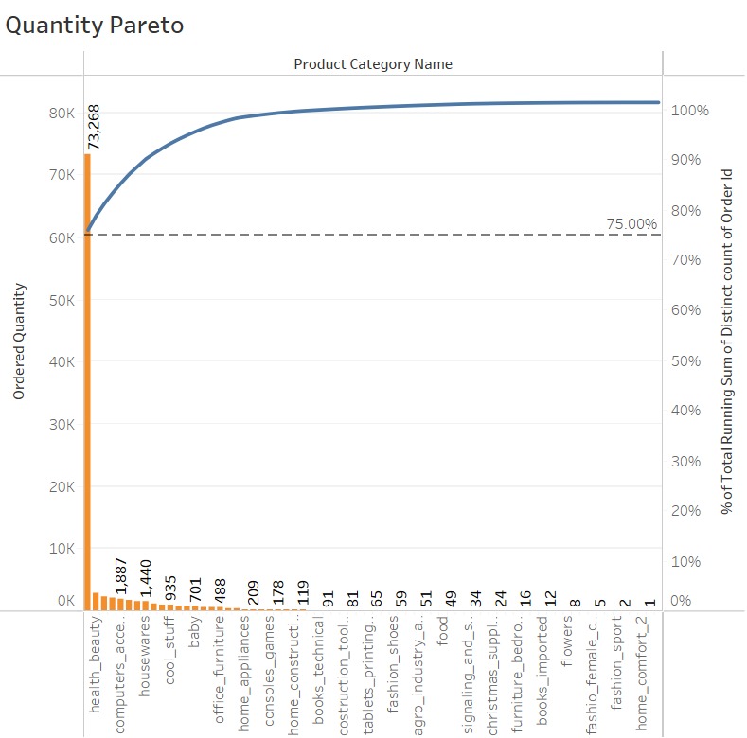
Visualizations
Quantity Pareto
Toys, health_beauty, and bed_bath_table account for 80.38% of the total orders.
Toys alone constitute 75.94% of the total orders, with the remaining categories generating 19.62%.

Slide 10
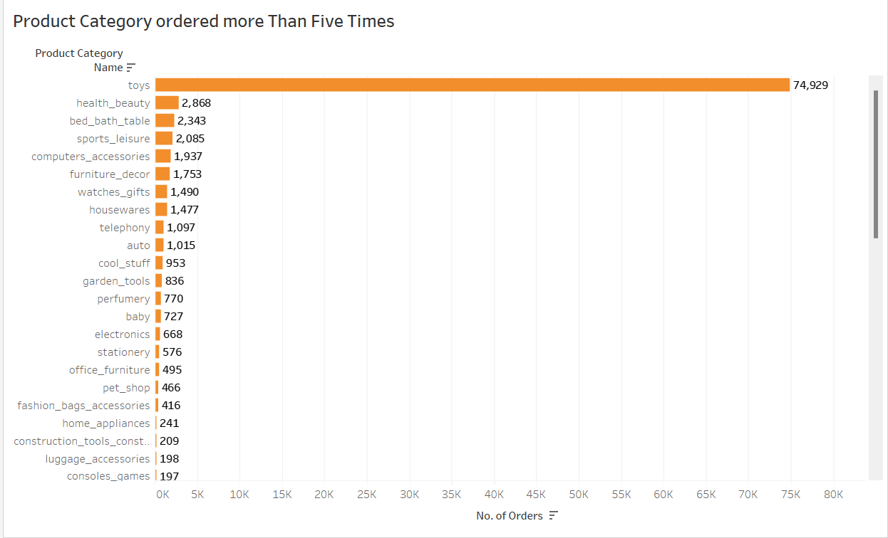
Visualizations
Product Category Ordered >5 Times
Toys are the most ordered category with 74,929 orders.
Following Toys, health_beauty, bed_bath_table, and sports_leisure are the next most ordered categories.

Slide 11
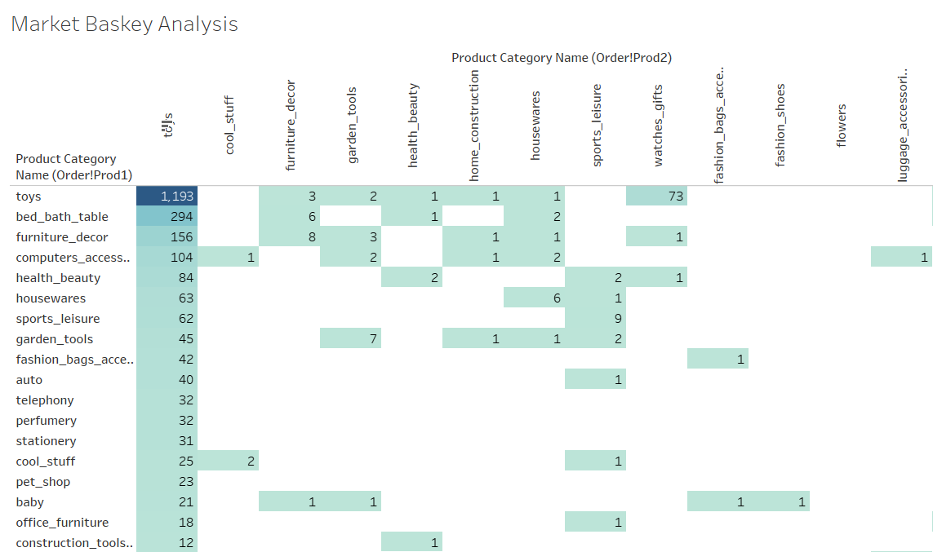
Visualizations
Market Basket Analysis
Market Basket Analysis identifies frequently ordered category associations.
Toys are most often ordered along with bed_bath_table, furniture_decor, computers_accessories, and health_beauty.

Slide 12
Insights
Our key insights are as follows:
Toys, constituting only 20% of the products, generate 80% of the revenue.
Despite higher prices, certain products are frequently purchased.
Besides Toys, products from bed_bath_table, furniture_decor, computers_accessories, and health_beauty are frequently ordered.
These categories, either individually or in combination with Toys, appear most frequently in customers' baskets.

Slide 13
Recommendations
Based on our findings, we recommend the following strategies:
Focus on maintaining inventory for categories generating over 80% of the revenue.
Target customers who are more likely to purchase toys to boost sales, as it is the most ordered category.
Offer promotional codes or discounts on frequently ordered category associations to encourage cross-selling.
Consider reducing subcategories with very low sales to optimize inventory management.

Slide 14
Appendix - Data Sources
Here's an overview of our data dictionary, which includes key information categories:
Order Details: This category encompasses data elements like order ID, order status, order purchase timestamp, and more.
Order Items Details: Within this category, you'll find information such as order item ID, seller ID, item price, shipping charges, and related details.
Customer Details: This section includes data related to customers, including customer ID, customer city, customer state, and other pertinent information.
Payment Details: Here, you'll find data pertaining to payment transactions, including payment type, payment value, and other relevant payment-related details.
Product Details: This category covers product-specific data, such as product ID, product category name, product dimensions, and related information.
We sourced our data from the OList retail dataset, which provides comprehensive information related to orders. This dataset covers the period from 2016 to 2018, allowing us to conduct a thorough analysis of historical data and draw meaningful insights.

Slide 15
Appendix - Data Methodology
Our data analysis process included:
Cleaning and transforming the dataset using Python libraries (Pandas and Numpy) in Jupyter Notebook.
Replacing missing values with suitable alternatives.
Removing redundant and duplicate records, retaining only the first occurrence.
Conducting exploratory data analysis using Python libraries (Matplotlib and Seaborn) in Jupyter Notebook.
Creating a new dataset for Market Basket Analysis, focusing on order id and product category name.
Performing various visualizations and Market Basket Analysis in Tableau.

Slide 16
Appendix - Data Assumptions
To maintain focus and relevance, we made the following assumptions:
Considered only cases with 'delivered' order status.
Assumed that the provided data achieved the desired revenue.
Assumed the company has no plans to expand to new warehouses.
Formulated recommendations under the assumption of continuous sales growth.

Slide 17
Conclusion
In conclusion, our analysis of OList's marketing and retail analytics has provided valuable insights into product performance, customer behavior, and revenue generation. By implementing our recommendations, OList can optimize its inventory, boost sales, and improve profitability, ensuring a more sustainable future for the company.

Slide 18
For Video Presentation: Click Here
Thank You!

